Slide 1
HOW TO PREPARE FOR ICE RAIDS AT YOUR CHURCH
This is a free digital handout provided by Hui Aloha ‘O Hawaii Indivisible

Slide 2
Goals For This Guide
Identify who is at risk and why we’re at risk
Know your rights – They are the same as immigrants' rights
Recognize judicial warrants
ICE tactics
How to respond respectfully, lawfully if ICE attempts to violate rights
The importance of video recording
Other actions you can take
Resources

Slide 3
Who is at risk?
8-million immigrants in the US are undocumented (no legal status);
6-million immigrants are known to DHS/ICE because of a prior grant of some temporary status or protection – like TPS, humanitarian parole, DACA – or because they have an active case in immigration court; Trump is actively stripping these temporary protections and accelerating the pace (and denials) of immigration court hearings.
Even people who are legally present or have permanent legal status (green cards), or are waiting for decision on lawful application, have been subjected to detention and deportation. In some cases, even US citizens have been detained and deported. Sources: The Politics of Immigration: Questions and Answers, Guskin and Wilson (2d ed. 2017); Pew Research Center (pewresearch.org): 2025 report; PBS.org Feb 6, 2025; “Who are the millions of immigrants Trump wants to deport?”, New York Times, 01/24/25.

Slide 4
Immigration Enforcement in Our Communities
Massive build-up of numbers of immigration officers in our communities.
Agents are pressured to meet quotas for “mass deportation”; routinely violating the law, ignoring the rights of migrants, arresting people for appearance only.
Massive and unnecessary detentions and family separation, and intentional abusive/dangerous detention conditions, to coerce migrants to give up their rights.
Performative terror and cruelty – made-for-TV propaganda of arrests made by masked, unidentified ICE officers, * terrorizes migrant communities and *feeds the MAGA myth that these workers and community members are animals, and “the worst of the worst.”

Slide 5
Are citizen allies who help their neighbors at risk?
Your risk is certainly less than non-citizens.
In 2025 the government has threated and attempted to prosecute ICE resistence:
* federal prosecutions based on lies, false evidence, and frivolous legal theories; see Dropped cases against LA protesters reveal false claims from federal agents, The Guardian, July 28, 2025;
* prosecutions of individuals who may have assaulted, physically obstructed, or impeded ICE enforcement efforts; see The Guardian, Sept. 2, 2025, (Spokane federal charges of allies).
If arrested by federal agents, call the Federal Public Defender of the District of Hawai’i, 808-541-2521.

Slide 6
Based on the pressure to arrest 3000 per day, they are now seeking to target churches
Trump DHS Plans Immigration Raids on Churches Over Holidays
Recently released information this month (November 2025)
https://thisweekinworcester.com/exclusive-trump-ice-raids-churches-holiday/

Slide 7
The Necessity of Knowing our Rights when Dealing with ICE

Slide 8
We all have constitutional rights, regardless of our immigration status.
To preserve them, we must exercise them.

Slide 9
When ICE is Outside Our Door – Church is Like a Business/Workplace
WE are STILL protected by the Federal Constitution & HI State Constitution & perhaps HI State laws.
We have the right to remain silent. If you answer, you consent to give up your rights
WE can refuse searches of our facilities & bodies if there is no valid search or valid judicial arrest warrant -
if there is a judicial warrant, they are to be let in
If they don’t have judicial warrant, they are asked to leave
If arrested, you have the right to speak with an attorney.

Slide 10
One Answer is All ICE Needs...
Where are you from?
What is your name?
If you answer: “I am from Mexico” (or anywhere besides the US) the burden shifts to you to prove your legal status.
Even if you just give your name, this may give ICE all they need to arrest you.

Slide 11
Begin with the law and Our Constitution.
You consent to give you right up, if you answer questions.
You consent to search if you allow it, if you agree to it, if you acquiesce to it, maybe even simply by allowing entry.
You have these rights, unless you consent to give them up.

Slide 12
Administrative Warrants
vs
Judicial Warrants

Slide 13
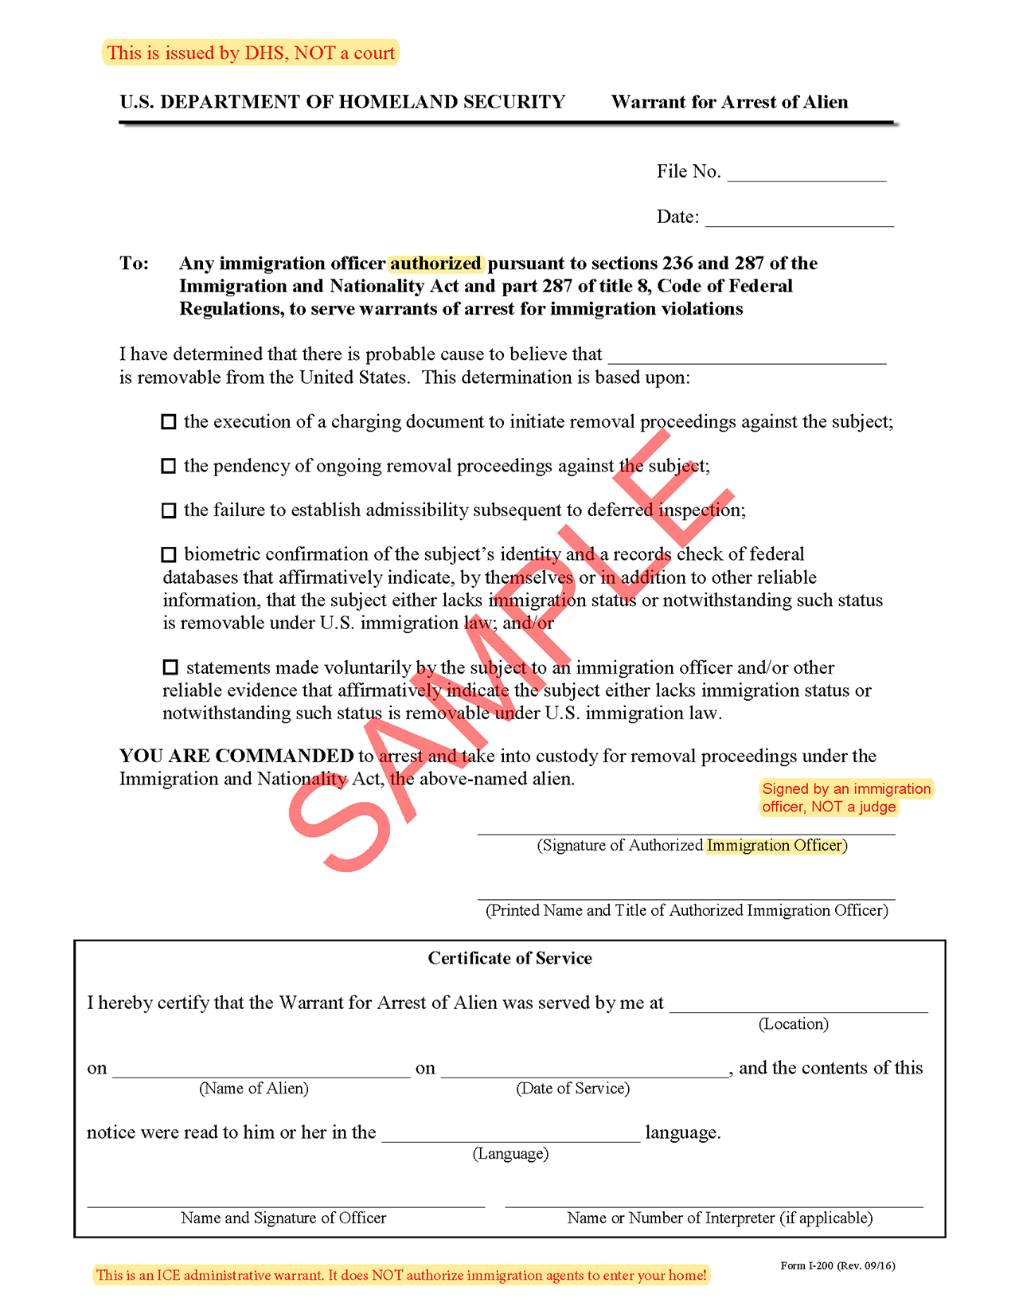
Administrative Warrant
is a DHS form signed by an ICE agent. This is NOT a legal basis for an ICE official to enter your home.

Slide 14
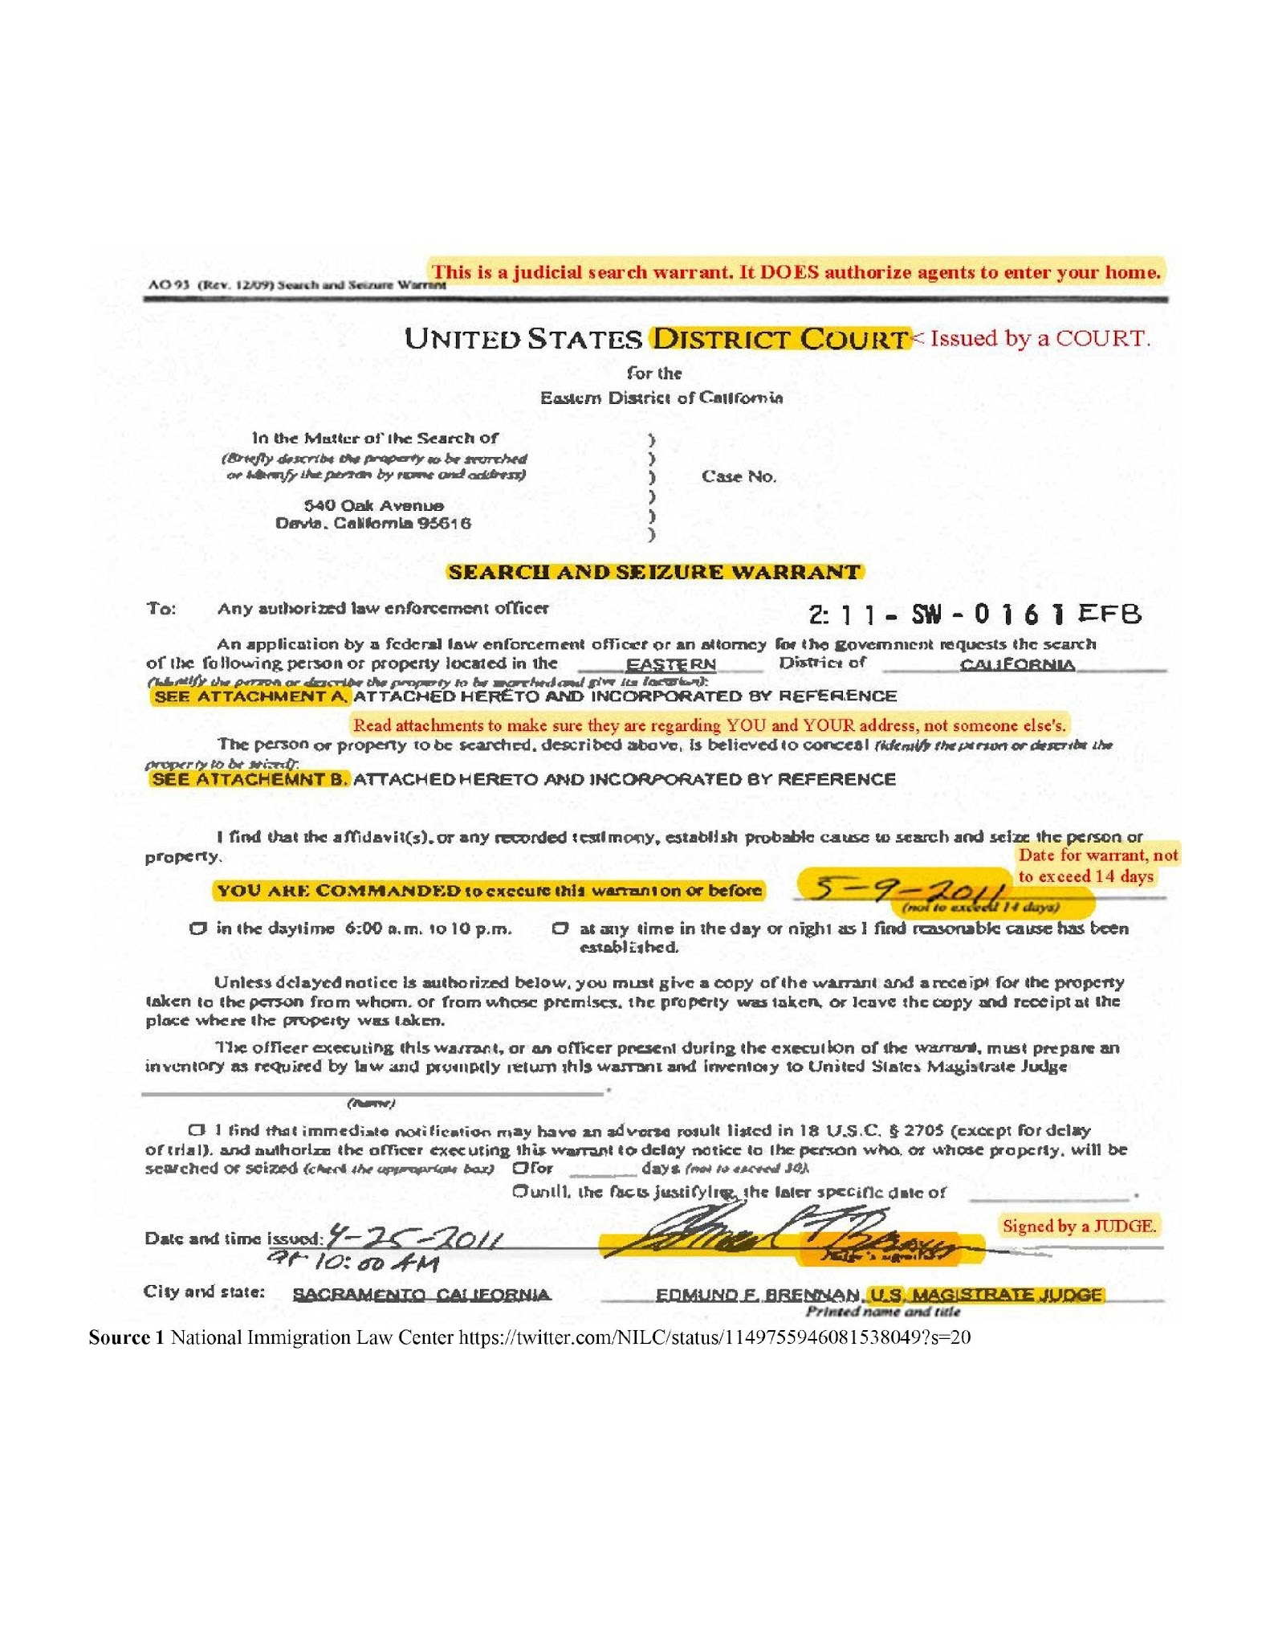
Judicial Warrant
Judicial Warrants authorize law enforcement officers to search the specified individuals or location/s listed in the warrant. They are:
Issued by a court,
states a person’s name, and address of location to be searched,
date must be within 14 days of issue,
signed by a judge.

Slide 15
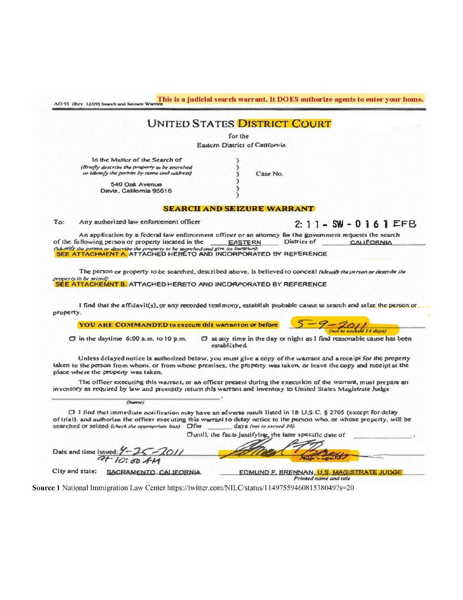

Issued by a Court
Read for name & address
Date cannot exceed 14 days
Signed by a judge / not DHS

Slide 16
ICE Tactics:
How does ICE get you to answer questions

Slide 17
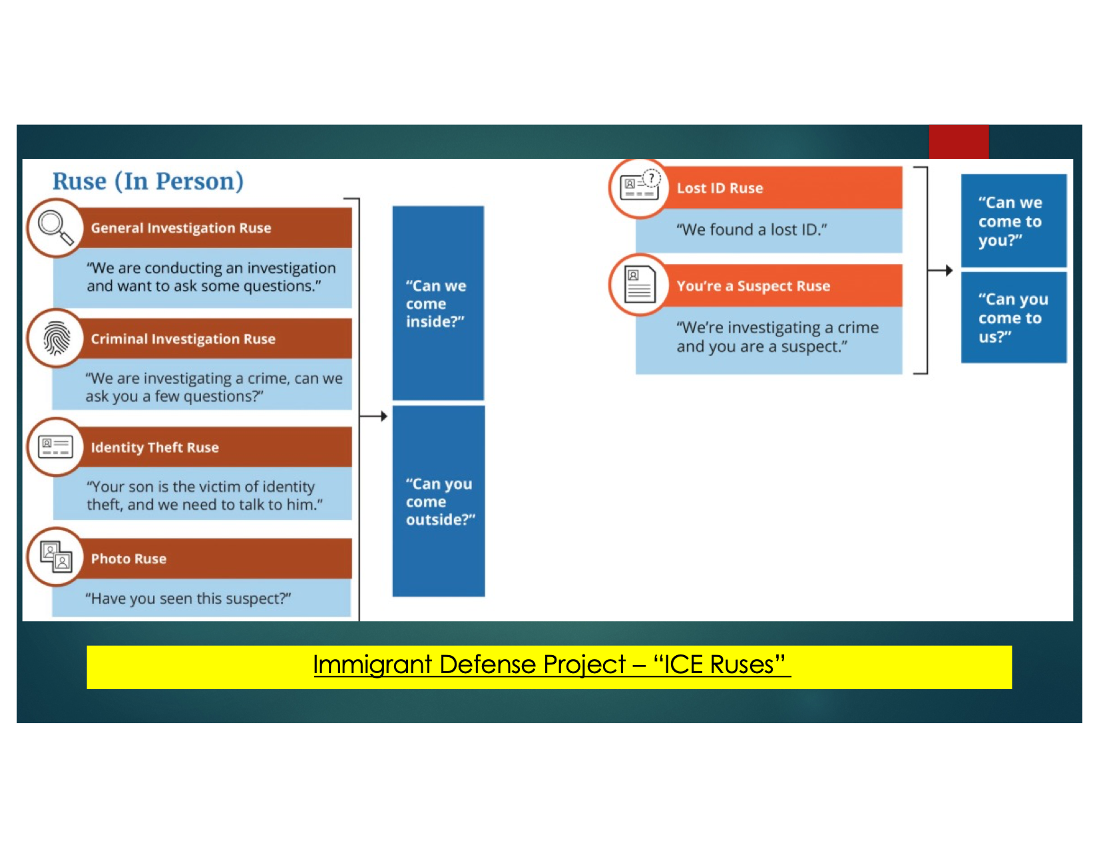

Slide 18
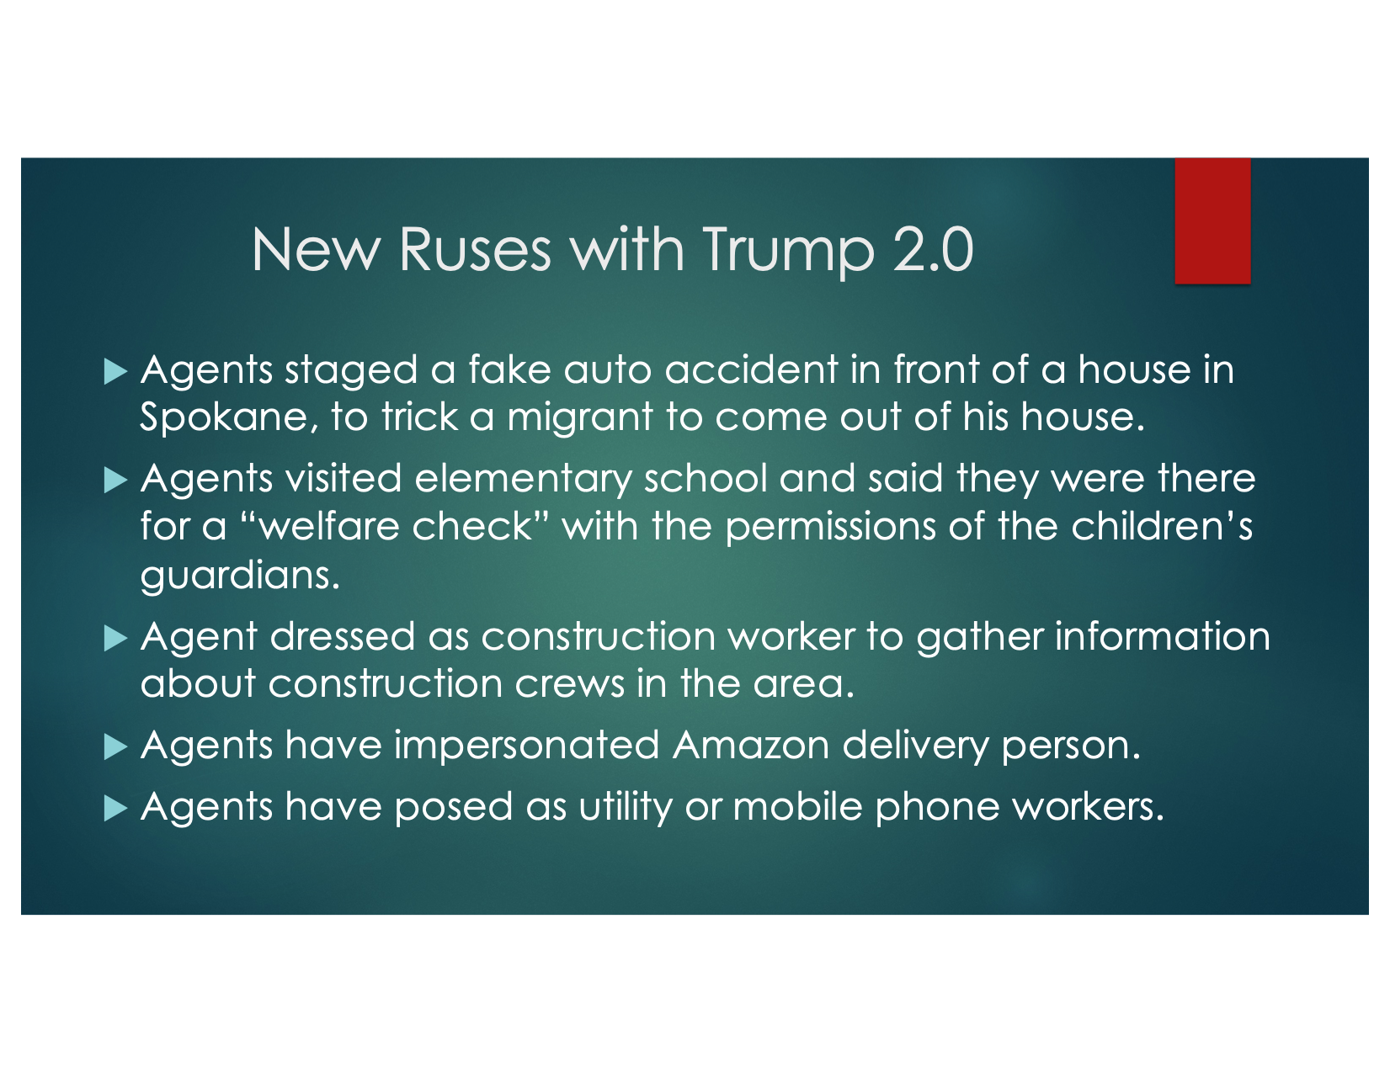

Slide 19
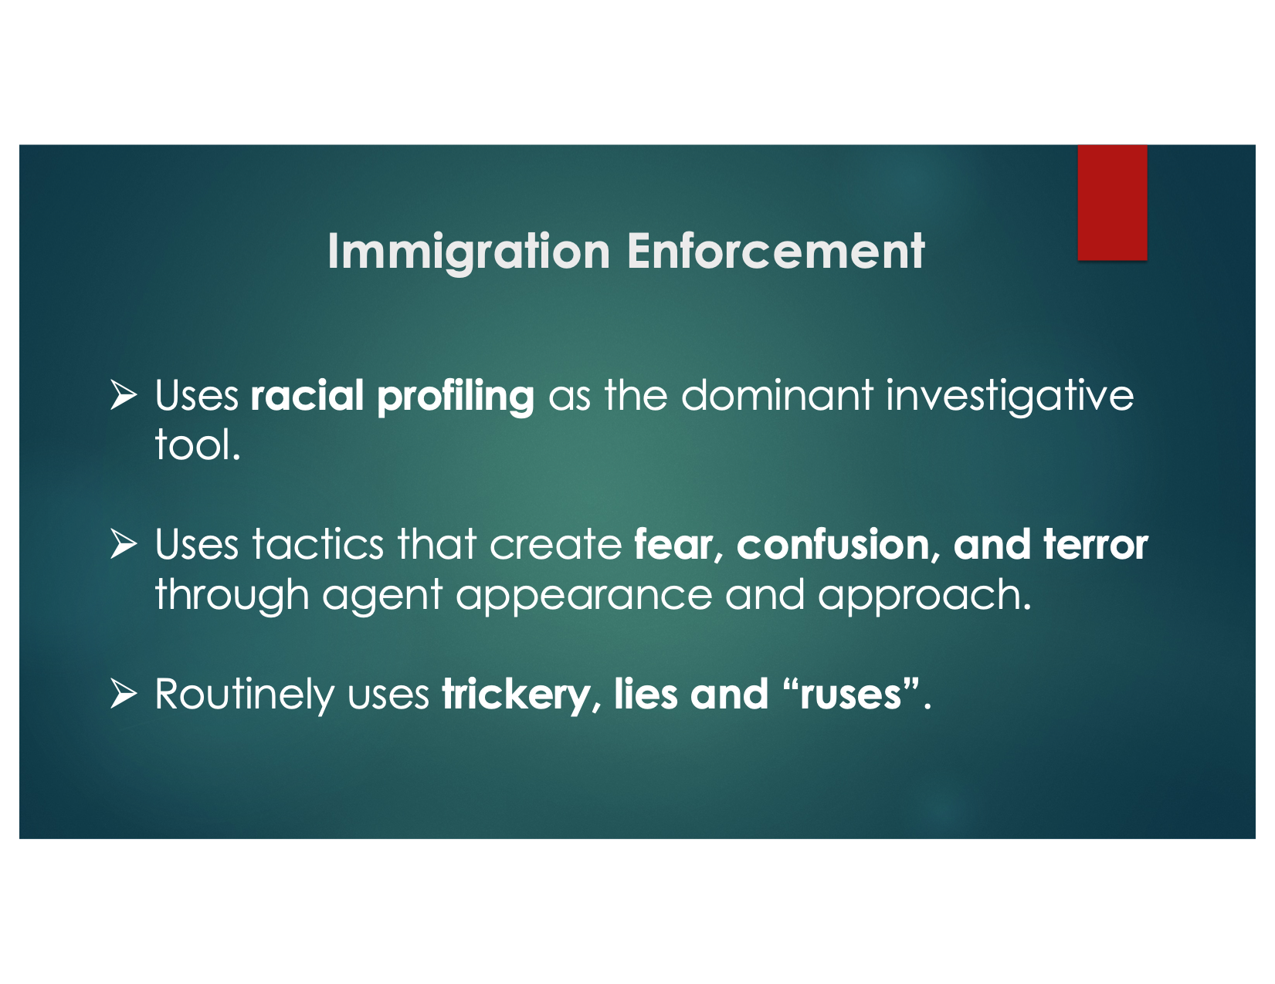

Slide 20
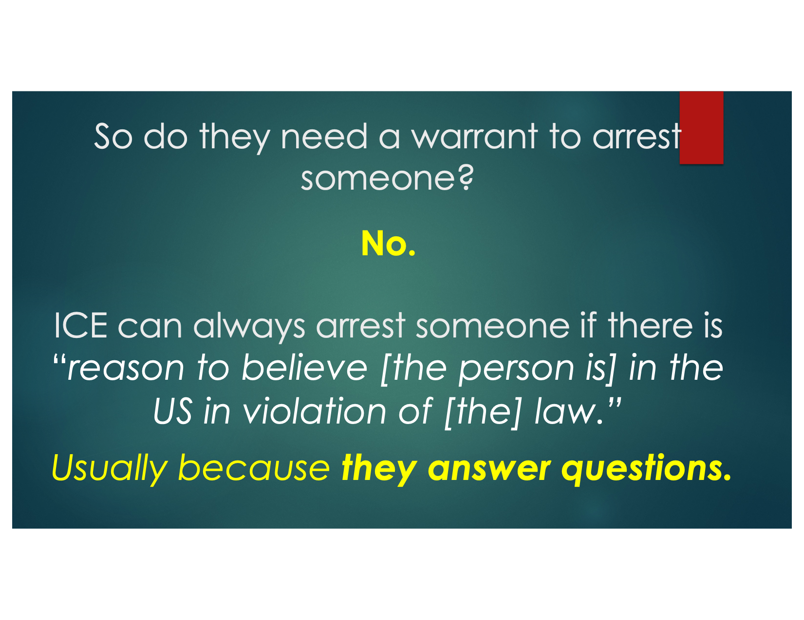

Slide 21
How to Respond if ICE Shows Up
RESPOND RESPECTFULLY AND WITHIN THE LAW.
EXERCISE YOUR RIGHT TO SILENCE.

Slide 22
White House Chief of Staff – Stephen Miller - ordered ICE/CBP to arrest 3,000 per day without regard to immigration or criminal status
ICE/CBP raids businesses / schools / healthcare /churches / organizations in 3 ways:
…without warning to arrest multiple people. Once on site they question, detain and arrest others.
…come without warning to arrest a specific person through targeted enforcement. Once on site they question, detain and arrest others.
…go to perform an audit to inspect I-9 forms required by employers. I-9’s confirm employee identity and authorization to legally work in the U.S.

Slide 23
Claim Your Space – Private & Public
Public Space – Sidewalks, streets, public parks; we have no right to restrict ICE
Private Space – Home, car, office; ICE prohibited from entering UNLESS they have judicial warrant or UNLESS YOU CONSENT
Public/private spaces – Reception areas, coffee house, restaurant, faith sanctuary, schools, libraries.

Slide 24
Private/Public Space
Churches can control these spaces with signage, with locked doors
Withdraw permission for ICE to be there, if ICE is disrupting the function of that space
If they don’t leave when they are told, they are trespassing

Slide 25
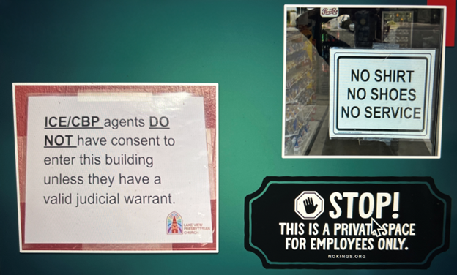
Signage Examples

Slide 26
IF YOU ARE HELPING IMMIGRANTS AT HOME, CHURCH OR ELSEWHERE, MAKE A CONCERTED EFFORT NOT TO ASK THEM ABOUT THEIR LEGAL STATUS: THEIR NAME, COUNTRY OF ORIGIN.
IF YOU ARE SUBSEQUENTLY DEALING WITH ICE, YOU CAN HONESTLY SAY YOU DO NOT KNOW THE ANSWERS TO THOSE QUESTIONS.
IF YOU DO KNOW ANSWERS, EXERCISE YOUR RIGHT TO REMAIN SILENT.

Slide 27
Churches As Employers

Slide 28
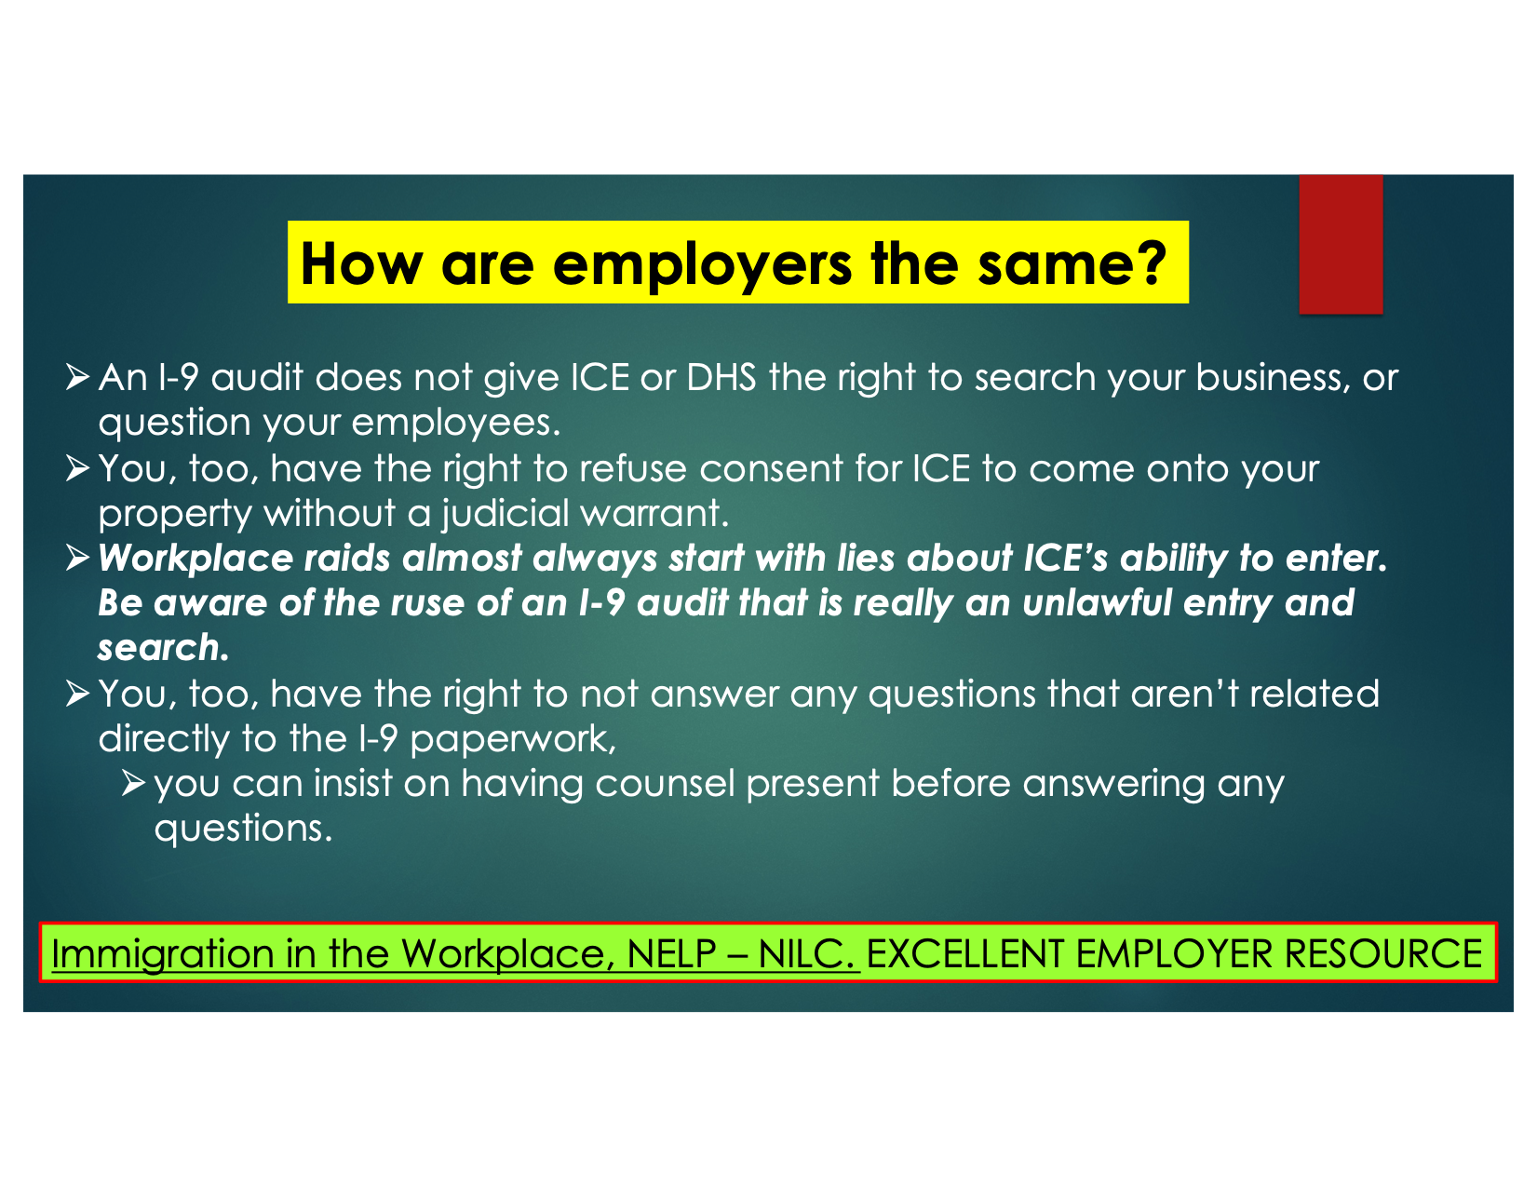

Slide 29
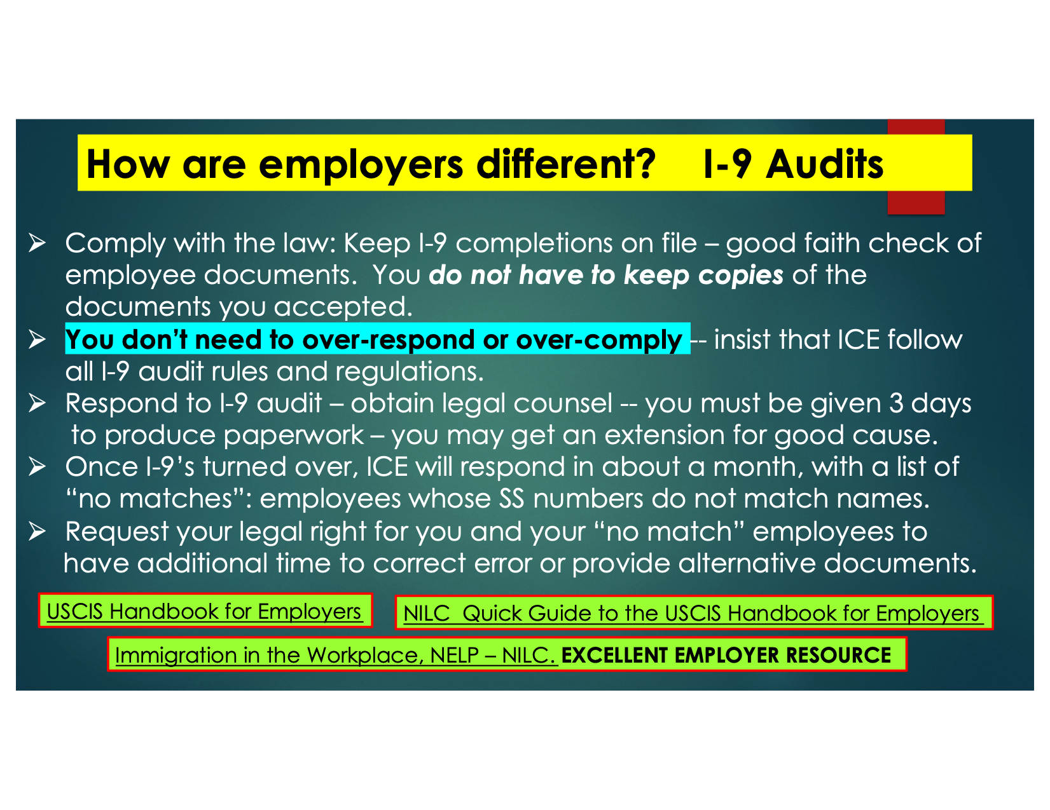

Slide 30


Slide 31
The Importance of Video Recording Encounters with ICE

Slide 32
Recording with cell phone….
Feds or HPD do not have a “reasonable expectation of privacy” if interacting with protesters on public street or raiding a home, business, or public place.
Can record (photo/video/audio) as an observer.
Observers cannot “interfere” with an ICE action, but can record.
If challenged, politely and calmly assert your rights to document.

Slide 33
General Rules in Hawaii - Recording
Document any ICE encounter as an observer
If at all possible, multiple people should record ICE actions with cell phones
Your goal - clearly document what is happening: was there a valid assertion of rights? Request for attorney? Illegal arrest?
Video may stop ICE from additional unlawful arrests of others at the scene
Videos can be used in immigration court, and to support lawsuits against systemic law violations
Do not obstruct agents; give space and give up more space if told to back up. Announce you are recording - it is your right and narrate as you record. Key is to be a lawful, non-violent witness

Slide 34
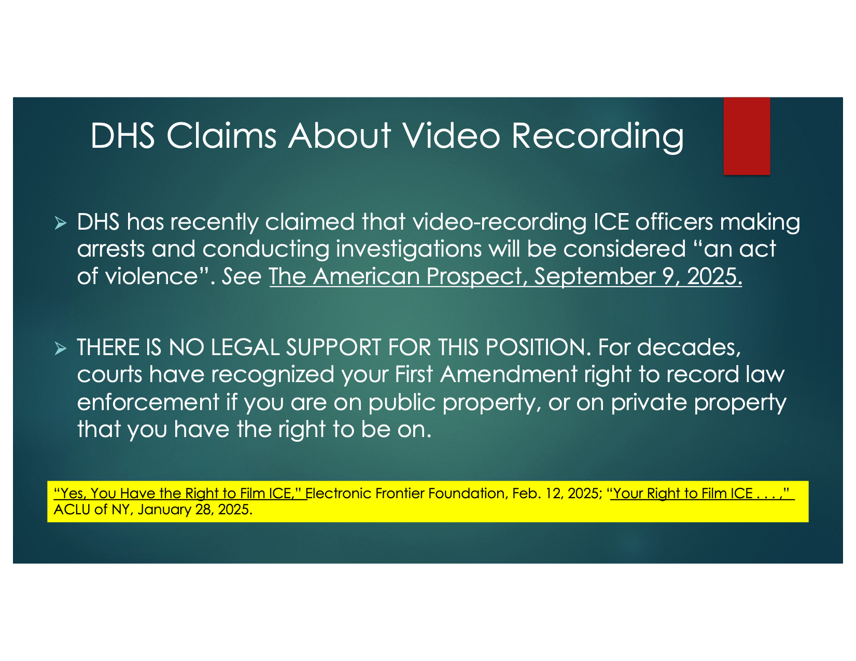

Slide 35
General Rules in Hawaii Recording… if Arrested
Feds or HPD cannot destroy our recordings, and must return them to us.
Feds or HPD cannot take or view our recordings without a warrant. However, laws are unsettled as to whether Feds or HPD can review our recordings if arrested.
Feds or HPD cannot force us to provide a passcode to our device without a warrant.
To restrict access, turnoff biometric data facial recognition and fingerprint recognition; so, they cannot hold our phone to our faces for access.

Slide 36
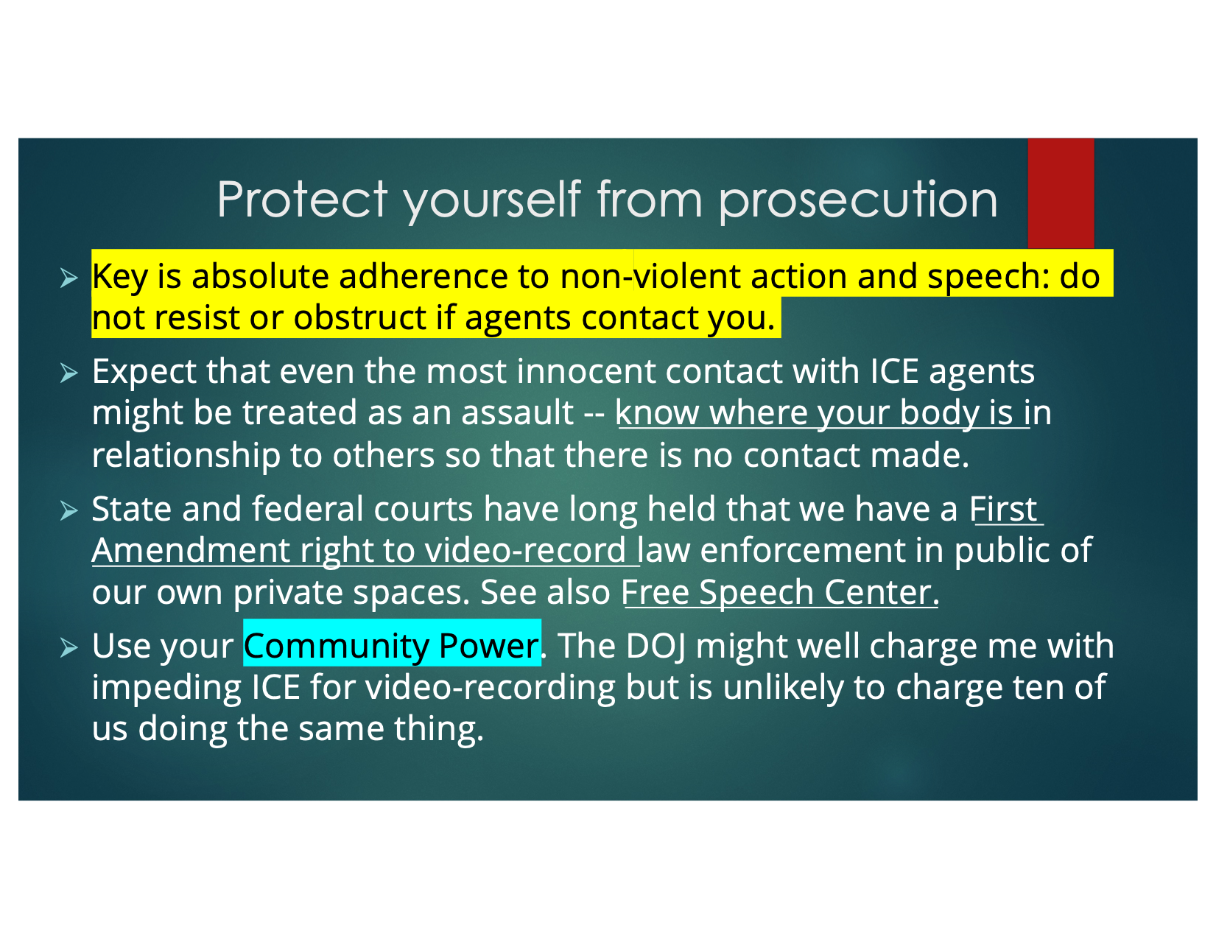

Slide 37


Slide 38
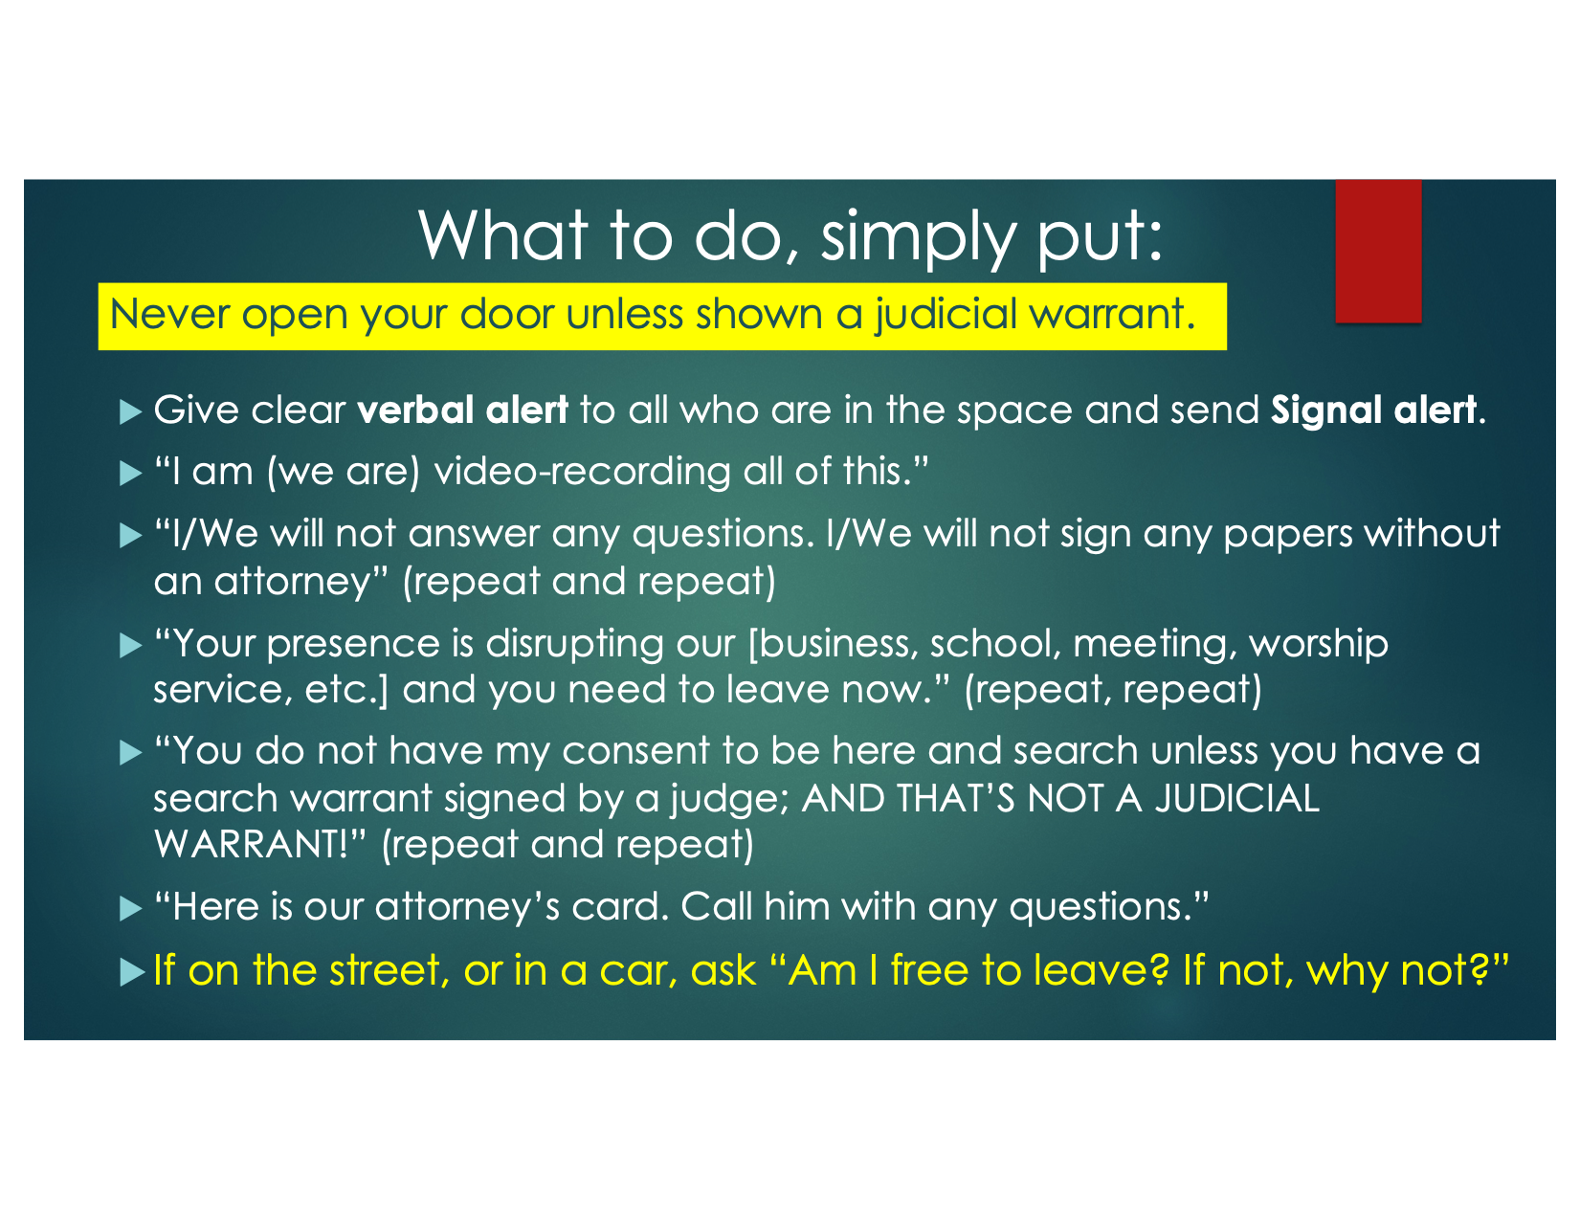

Slide 39
Other actions churches can take
Contact an Indivisible Chapter on your island (IndivisibleHawaii.org) to access important resources for helping immigrants and dealing with ICE, including asking for Know Your Rights Cards. They can also inform you if there are any Rapid Response groups on your island.

Slide 40
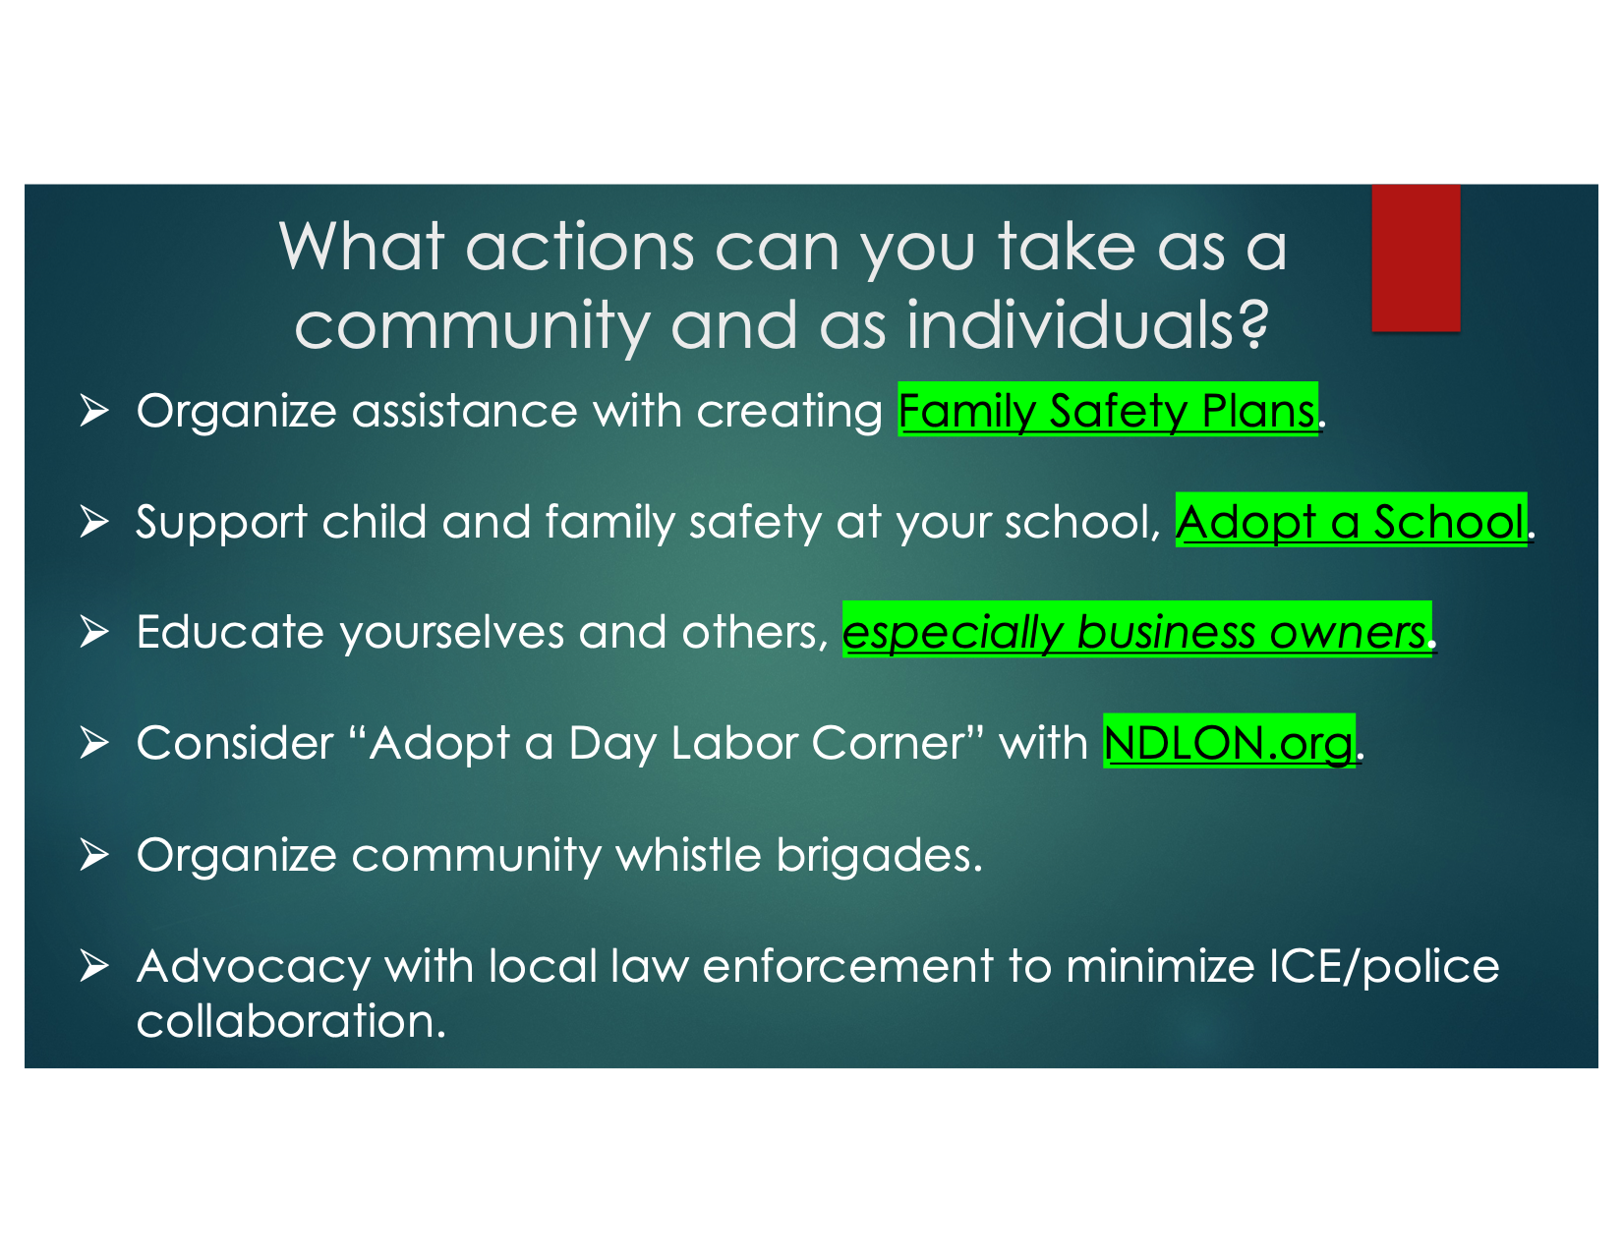

Slide 41
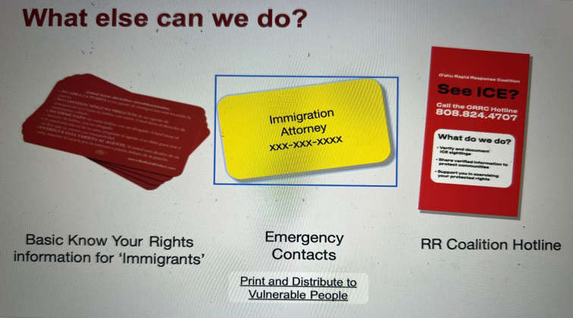

Slide 42
Resources

Slide 43


Slide 44
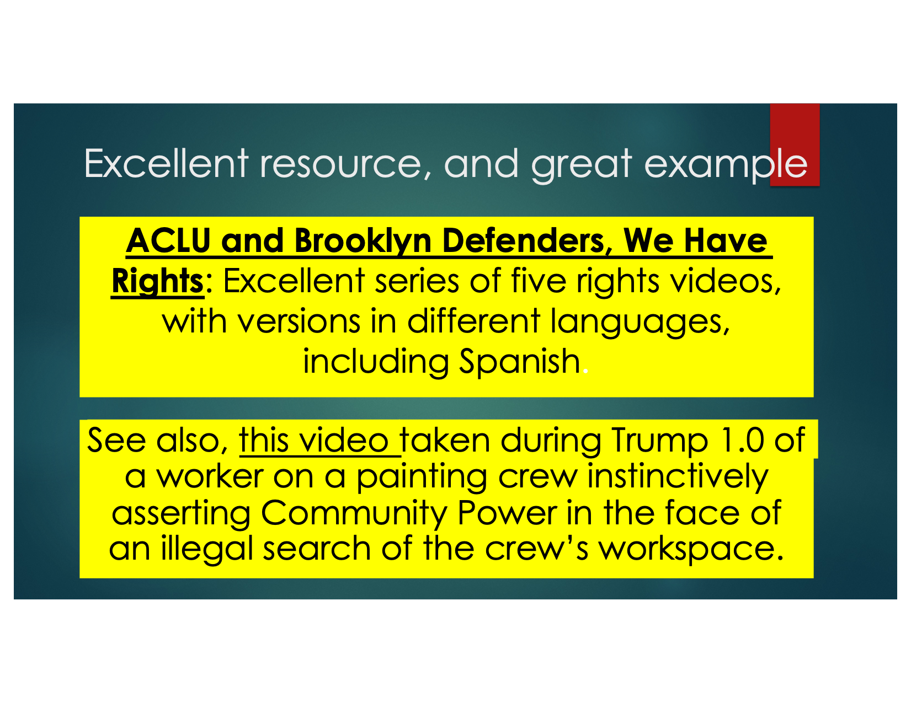

Slide 45
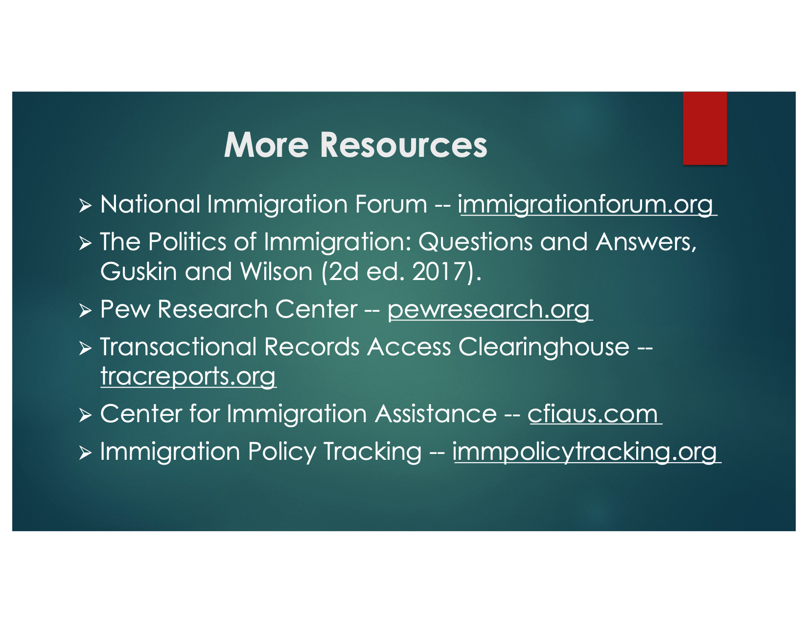

Slide 46
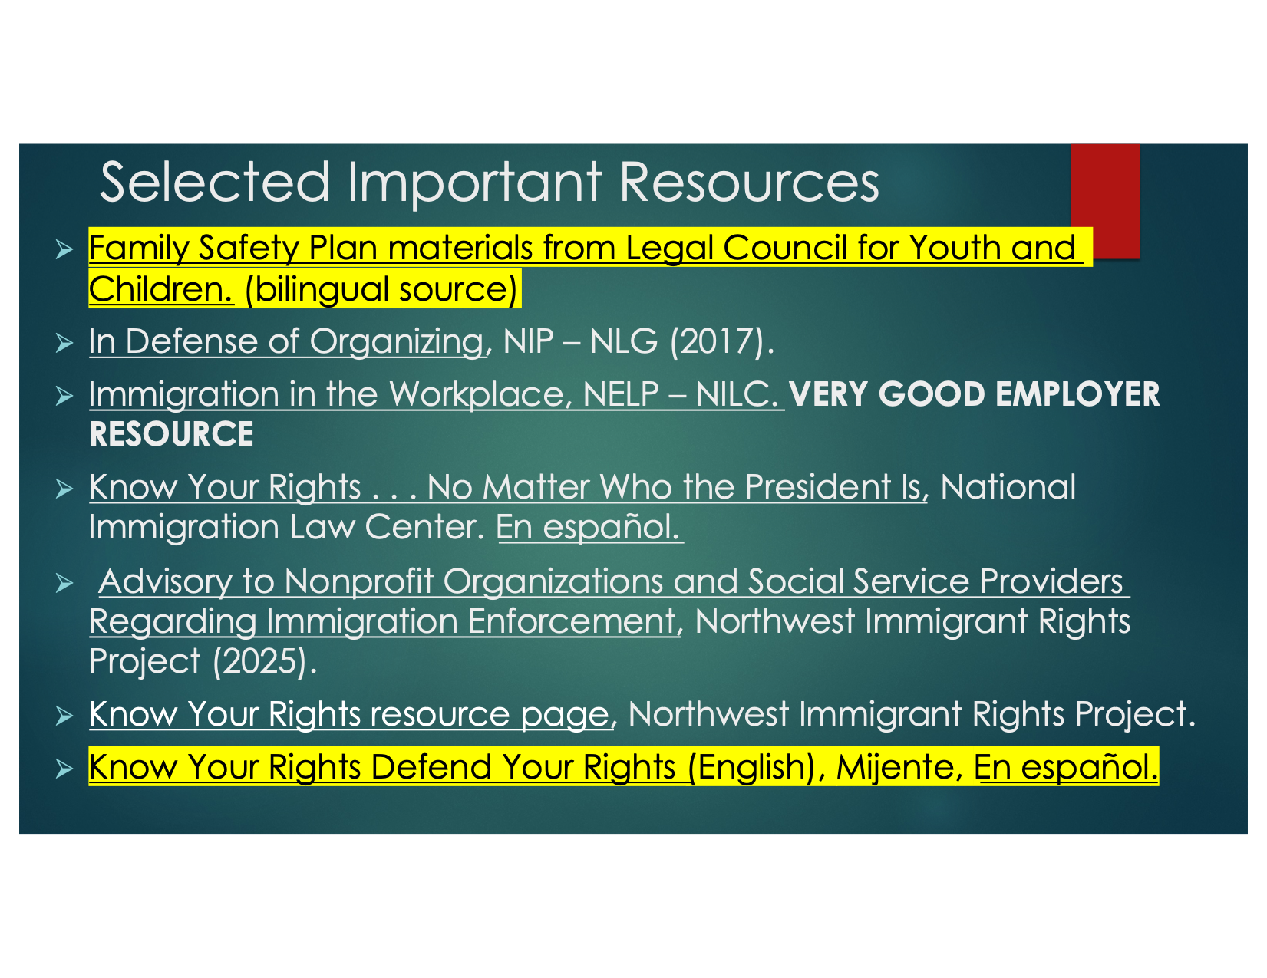

Slide 47
Hui Aloha ‘O Hawai‘i has recently expanded to become a statewide chapter of the Indivisible Hawai‘i Statewide Network. Many of our members are ministers or those with faith-based backgrounds. One of our goals is to invite faith-based individuals and groups focusing on social justice to join us. We also have many members in the helping professions – physicians, therapists, etc. Drawing from the expertise of Chapter members, we engage with the intersections of health/well-being and social justice that impact our communities, such as advocating for vaccines, and continuing to support advancements in medical research.
We have multiple faith involvement, including Christian, Jewish, & Buddhist members. Our leadership team includes the Rev. Dr. Scott Landis, retired minister with the United Church of Christ, the Rev. David Gierlach, a retired priest with the Episcopal Diocese of Hawaii and a retired attorney and per diem judge, the Rev. Dr. Robert Nelson, retired priest with the Alaskan Diocese and associate member at Keawala'i Congregational church, and Dr. Ellen Caringer, a psychologist & neuropsychologist and leader of Hui Aloha 'O Hawaii Indivisible.

Slide 48
Thank you to Jay Stansell, J.D. & Gaye Chan for sharing their knowledge and information

